Slide 1
Why Test Automation Efforts Fail Jim Zuber, CTO PNSQC – October 15, 2019

Slide 2
Test Automation - The Plan
Test automation efforts start with great enthusiasm
In short order all the tests will run automatically at the click of a button!
Our release cycles will shorten, we will save money, life will be good
It can’t be that hard

Slide 3
Test Automation – The Reality
The tools don’t quite work as advertised
The automation is a bit trickier than expected
And everything takes longer than estimated
Automation is hard

Slide 4
Automation Train Wreck
As automated test cases get completed they are rolled into the software release process
GUI changes trigger false failures, diverting developers to maintenance activities, slowing new automation efforts down
A few automation team members quit or get reassigned and maintaining their code is quite difficult
Management starts to get disillusioned by the slow progress
A budget crunch or management champion departs and the plug gets pulled

Slide 5
Best Practices Recommendations
This “Train Wreck” doesn’t have to happen to you!
QualityLogic has been helping customers automate testing for 30 years and we would like to share some of our best practice insights

Slide 6
Management Commitment
Test automation can generate a huge ROI, but it takes time
Automation is not a closed ended project, but a fundamental change in how the testing aspect of software development is done!
Management must be committed to the effort and their expectations must be carefully calibrated

Slide 7
Staff Skills and Experience
For automation of applications with complex business logic, programming skills are needed
Sr. Developers can develop reference test cases, while junior staff can use those for derivative test cases
Target a common language so code can be leveraged. We’ve had great success with Python
Before hiring have prospects do a coding test in the language of choice
Use staff members or outside consultants that have been there, done that from an automation perspective. Don’t reinvent the wheel!

Slide 8
Domain Knowledge and Team Size
Automation developers should have some knowledge of the product they are automating
And an understanding of the domain within which the application is used
Without this developers will do what you ask, but perhaps not what you need
And developers won’t “see” problems obvious to anyone familiar with the application or domain
Adequately staff for both the automation development AND the maintenance once tests go live. You will need to maintain tests!
Have some redundancy in staffing. Will your project fail if a single developer quits?

Slide 9
Which Test Cases to Automate?
Tests you want to run every build
Tests that need to be run across multiple platforms
Tests with the most frequently used functionality
Tests that are time consuming to manually test
Start by automating a smoke test
Or get a quick success by automating the low hanging fruit
Avoid test cases with unpredictable results

Slide 10
Tool Selection
Commercial Tools?
Robust, complete solution, easier to use, training and support, less buggy, but expensive
Open Source Tools?
Free, user community support, some are surprisingly robust but not all, integration issues if multiple tools are needed, some are de facto standards (i.e. Selenium)
Hybrid Solutions
Commercial tool with a lite open source version (i.e. SoapUI)

Slide 11
Automation Test Tools
Dumb Record & Playback Test Tools
A brute force recoding of user interactions with the application. Fragile!
Smart Record & Playback Test Tools
More adaptive recording of user interactions with the application, storing multiple object identifiers and leveraging machine learning to adapt to GUI changes
AI Assisted Auto Discovery & Playback
Self-discovery of paths through the application with the ability to playback discovered paths. Able to adapt to some GUI changes
Abstract Syntax Test Tools
Use of natural language, keywords, or procedural text (think Cucumber/Gherkin) to define test cases. Underlying automation code may be auto generated or need to be coded

Slide 12
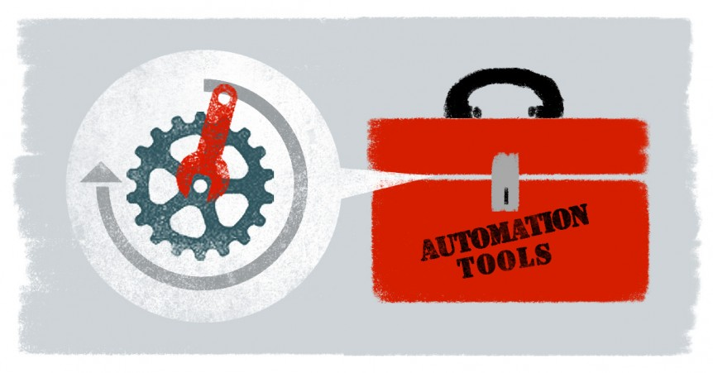
Automation Test Tools
Hand Coded Test Development
Use of common programming languages to define automated test cases using an underlying automation API such as those supported by Selenium, Appium, or mobile device operating systems
Best tool depends on…
Complexity of business logic in application
Rate of application change
Skills of QA staff using tool

Slide 13
Test Design and Scope
Tests should focus on clear and narrow objectives, replicating typical user interaction. Easier to code, debug, and maintain
Start with good manual test
Clear guidance on test intent, preconditions, user actions, expected results
Use of abstract syntax like Gherkin can help clarify intent, but can add coding complexity

Slide 14
Test Case Coding
Coding Guidelines:
Test case and variable naming conventions
Object location strategies (use more than one)
Hard or soft asserts
Wait handling
Page object pattern usage
Data driven test inputs
Minimal dependencies with other test cases
Test automation is software development. Robust source code management is a must using platforms like GitHub

Slide 15
Artificial Intelligence
Many exciting applications emerging that leverage AI…
AI assisted auto path discovery and playback
Self healing automation scripts
AI extracted user paths from log data
Natural language analysis of test requirements and procedures
Image analysis and comparison for acceptance validation
Many of these AI applications promise to radically simplify software test automation, but beware of the hype as it is still early days in the AI revolution!

Slide 16
Similarity Analysis – Case Study
QualityLogic’s AI efforts have focused on optimizing automation efforts through the analysis of manual test procedures. A case study….
The Client:
Large streaming content provider
Content runs over ten platforms including mobile, web , and OTT
5,000 manual test cases run cumulatively run across all platforms
The Challenge:
Expanding feature sets
Sprint times decreasing
Test budget constrained
Reducing test coverage high risk
Cross platform automation solution in planning stages

Slide 17
Similarity Analysis – Case Study
The solution:
Use internally developed AI software to identify manual test cases with high degrees of similarity
Methodology used included Jaccard, Cosine, and other text similarity algorithms along with a proprietary genetic clustering algorithm. Focus of analysis included…
Finding duplicate and very similar test cases on a platform specific basis
Test cases that were similar cross platform
Isolation of common test sequences that could coded in common libraries
Clustering of similar test cases for assignment to the same automation developer
Predictive ordering of test cases to maximize automation code sharing between test cases

Slide 18
Similarity Analysis – Case Study
The Outcome:
4% duplicate platform specific test cases
Average of 46 clusters of almost identical platform specific test cases identified with a potential to reduce automation efforts by 10%
Cross platform, over 1000 clusters of almost identical test cases identified, with the potential for 20% reduction in automation effort, assuming test scripts can be run cross platform
Potential efficiencies from identifying common code sequences for libraries, clustering for assignments, and development order sequencing have not been quantified yet

Slide 19
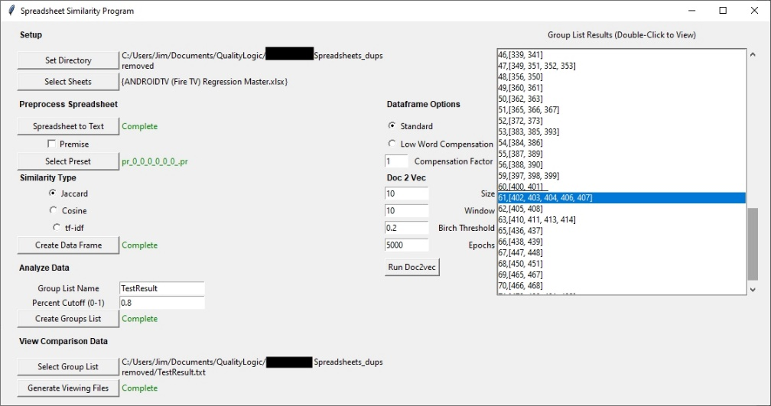
Similarity Analysis – Methodology
Developing the similarity AI analysis was not rocket science, although it required a considerable amount of experimentation to optimize
We used an simple application to allow us to play with the AI processing pipeline variables including….
Normalizing the manual test case representation
Text preprocessing (caps, stems, stop words, etc.)
Selecting different similarity algorithms
Clustering similar test cases
Presenting results for analysis
Now part of our service SOP!

Slide 20
Questions?

